Slide 1

Creating expert bots using Microsoft Bot Framework, Azure Cognitive Services and NER systems
Oleksandr Krakovetskyi CEO, DevRain Solutions @msugvnua alex.krakovetskiy@devrain.com https://fb.com/alex.krakovetskiy

Slide 2
About
CEO of DevRain Solutions.
CTO DonorUA/Udonors (quick search of blood donors).
Microsoft Regional Director.
Microsoft Most Valuable Professional.
Best Professional in Software Architecture (Ukrainian IT Award).
Ph.D. in Computer Science.

Slide 3
Why expert bots?

Slide 4
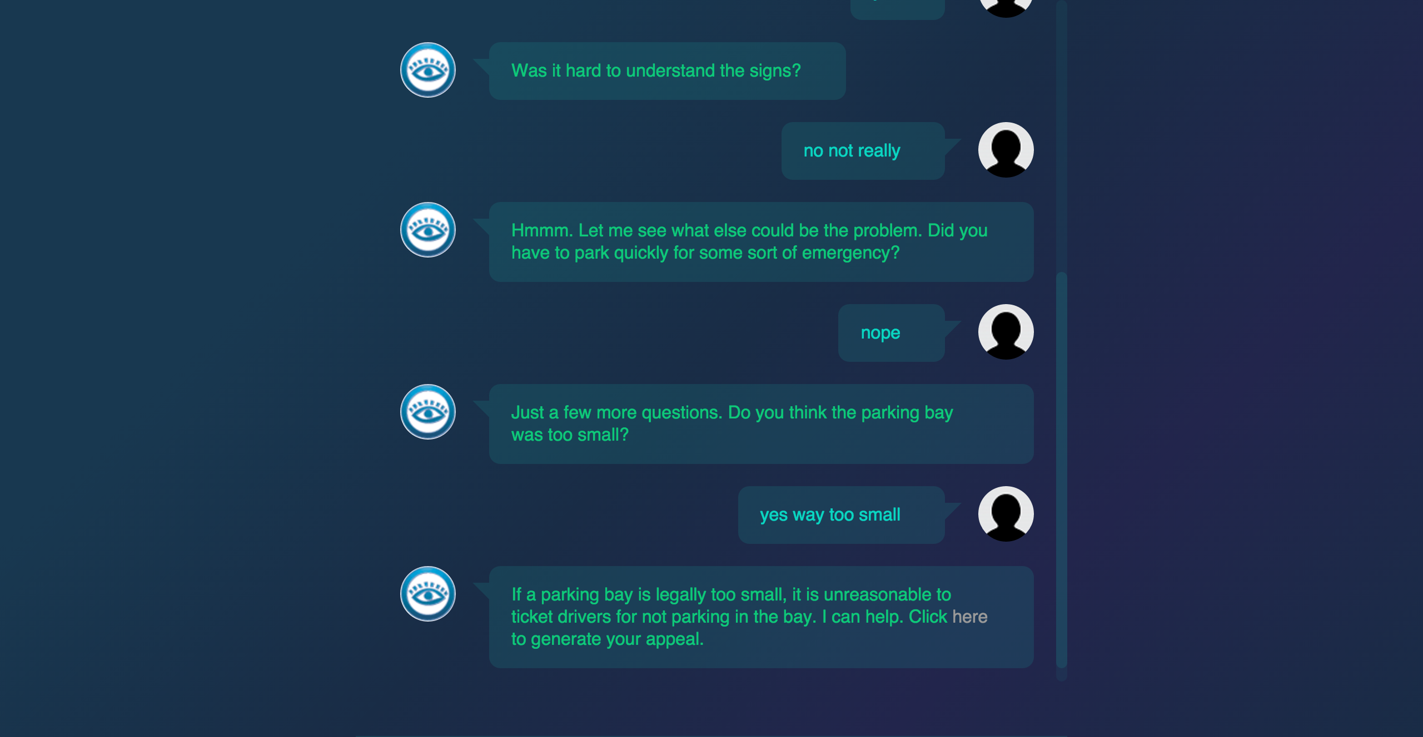
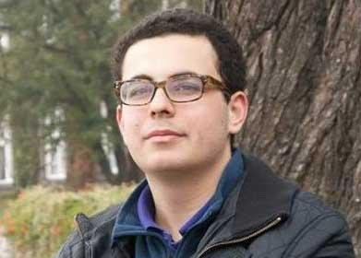
A 19-year-old made a free robot lawyer that has appealed $3 million in parking tickets http://www.donotpay.co.uk/

Slide 5
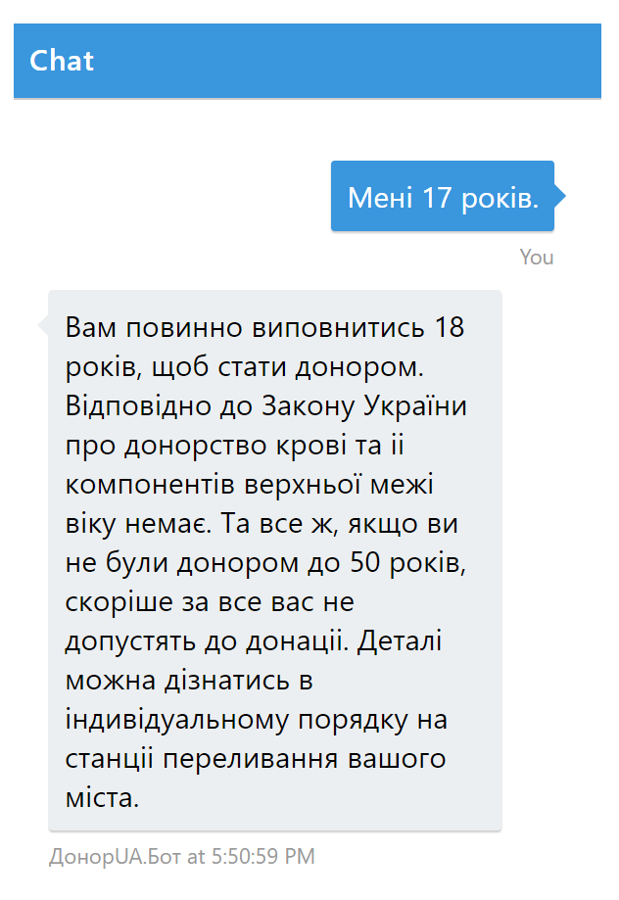
Check if you can donate blood with DonorUA.Bot https://donor.ua/bot Available for Telegram, Skype, Messenger, Email, Web

Slide 6
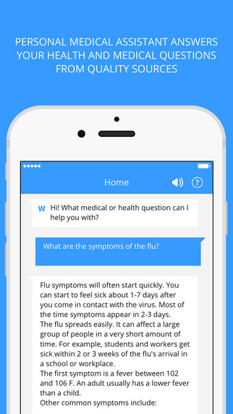
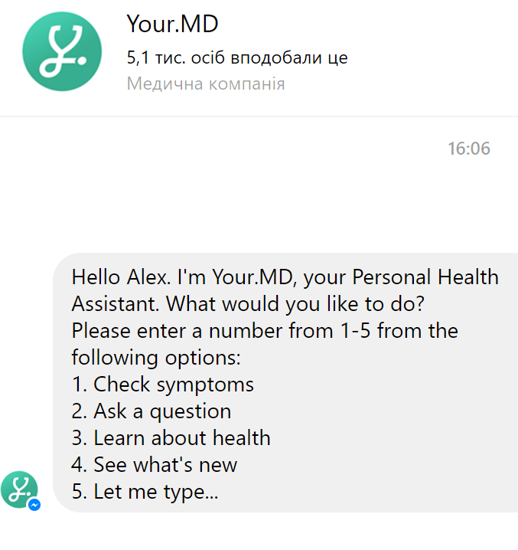
Existing Healthcare Projects
MedWhat is an artificial intelligence medical assistant that can answer questions, such as drug side effects.
Your.MD calls itself an artificial intelligence personal health assistant. It is chatbot that you can ask healthcare related questions. For example, you can ask about your symptoms.
https://tincture.io/chatbots-made-for-healthcare-fec631bc8462

Slide 7
Chatbot development challenges
Multiple platforms. Skype, Kik, Telegram, Whatsapp, Line, Slack, HipChat, Facebook Messenger, WeChat, Twitter, Viber, Email, iOS, Android, Windows, Web, Email etc.
Text understanding (specially Cyrillic languages).
Authorization, personalization and anonymity.
Dialogs, state management.
Monetization.

Slide 8
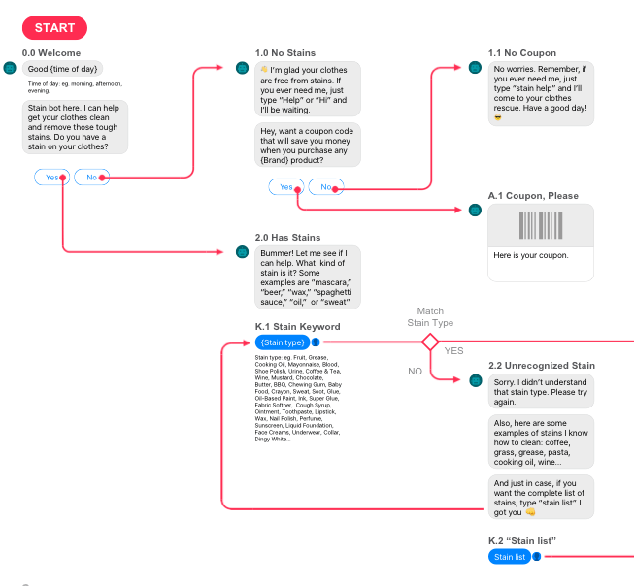
What you will need?
Knowledge database.
Bot conversation flow (predefined dialogs, Q&A, decision trees).
Text understanding.
Distribution channels.
Analytics for system improvement.

Slide 9
Natural Language Processing
Natural language processing is a field of computer science, artificial intelligence, and computational linguistics concerned with the interactions between computers and human (natural) languages.
Named Entity Recognition
Stemming
Age detection
Gender detection
Language detection
Sentiment analysis
Translation
Spell Checking

Slide 10
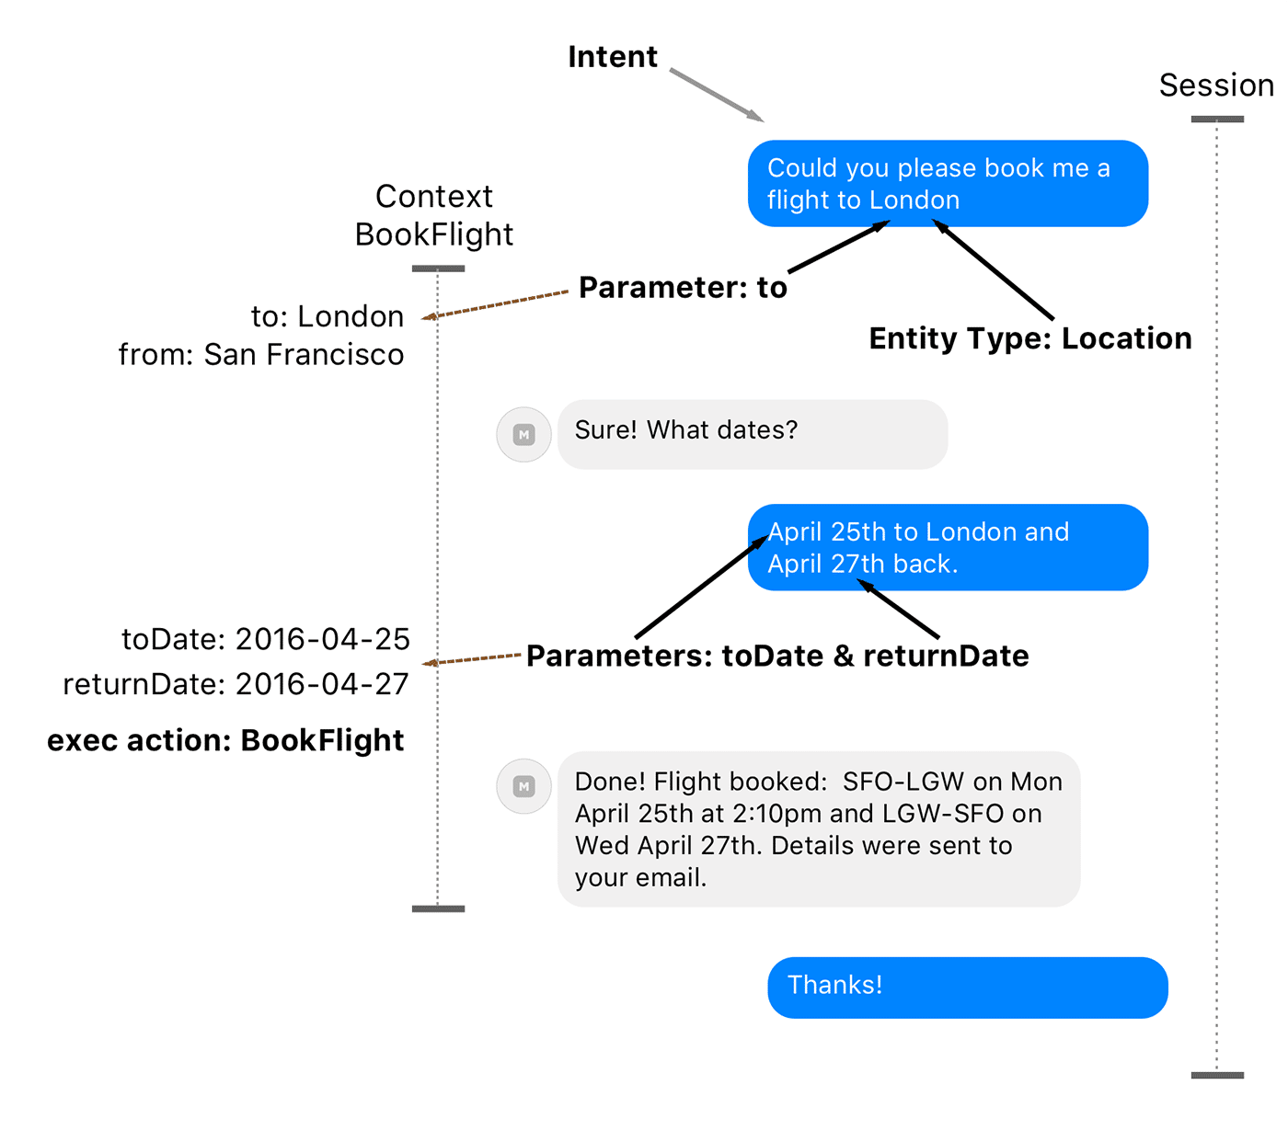
Azure Cognitive Services
Web Language Model API
Translator API
Text Analytics API
Bing Spell Check API
Language Understanding Intelligent Service
Linguistic Analysis API
QnA Maker
Bing Autosuggest API
https://www.microsoft.com/cognitive-services/en-us/apis

Slide 11
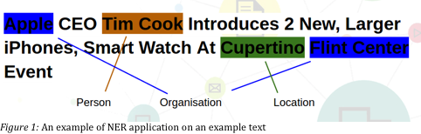
Named Entity Recognition
Subtask of information extraction that seeks to locate and classify named entities in text into pre-defined categories such as the names of persons, organizations, locations, expressions of times, quantities, monetary values, percentages, etc.

Slide 12
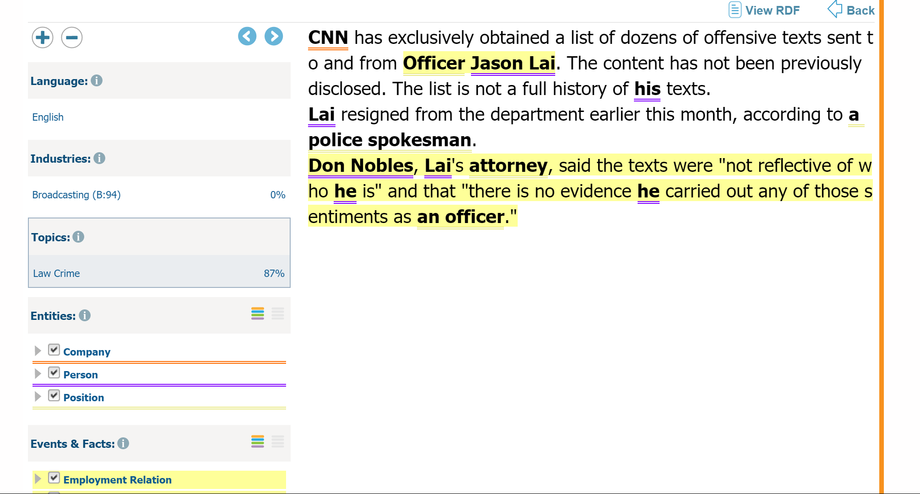
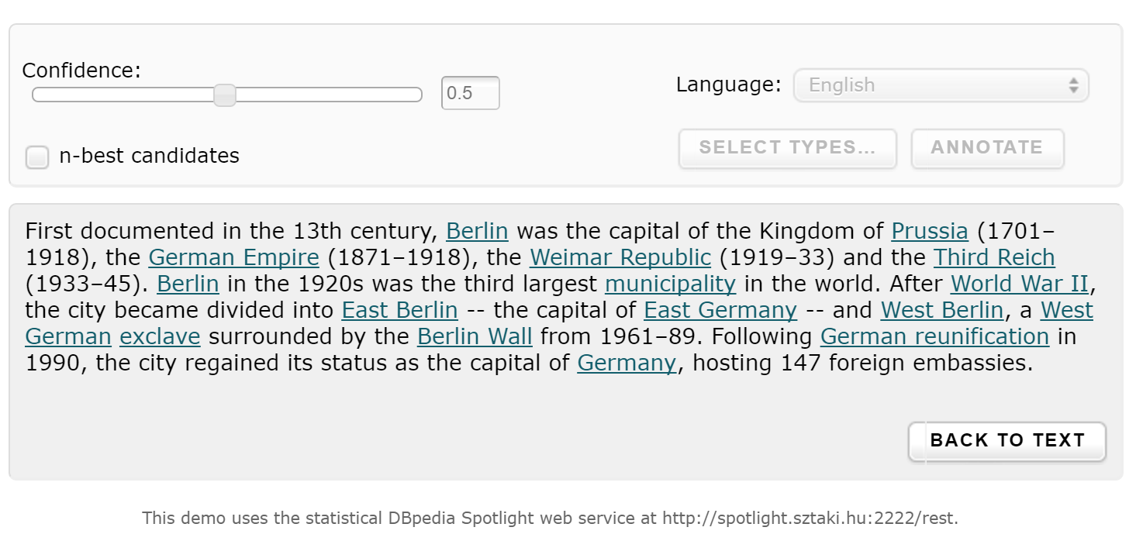
OpenCalais & Dbpedia Spotlight

Slide 13
NER Tools
http://msg.ai/
OpenCalais https://www.opencalais.com/opencalais-demo/
Dbpedia Spotlight
AlchemyAPI
BitextAPI https://www.bitext.com/text-analysis-api/
CogitoAPI http://www.cogitoapi.com/
Entitizer (Romanian, Russian, Bulgarian, Hungarian) http://klangoo.com/search.aspx
Magnet by Klangoo (40+ languages, including Klingon ...) http://klangoo.com/search.aspx
MeaningCloud http://www.meaningcloud.com/
Ingen.io https://www.quora.com/topic/Ingen-io
Rosette (many European, Middle Eastern and Asian langauges) https://developer.rosette.com/
Saplo https://www.quora.com/topic/Saplo-company
Semantria https://www.quora.com/topic/Semantria
Aylien.com http://aylien.com/
TextRazor https://www.textrazor.com/
Wolfram Alpha https://www.wolframalpha.com/
Microsoft Cognitive Services & Azure ML https://www.microsoft.com/cognitive-services/en-us/apis

Slide 14
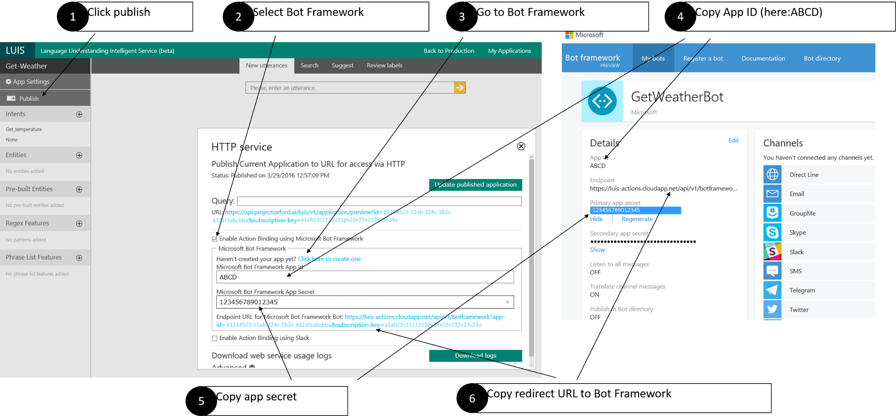
LUIS
Language Understanding Intelligent Service https://www.luis.ai

Slide 15
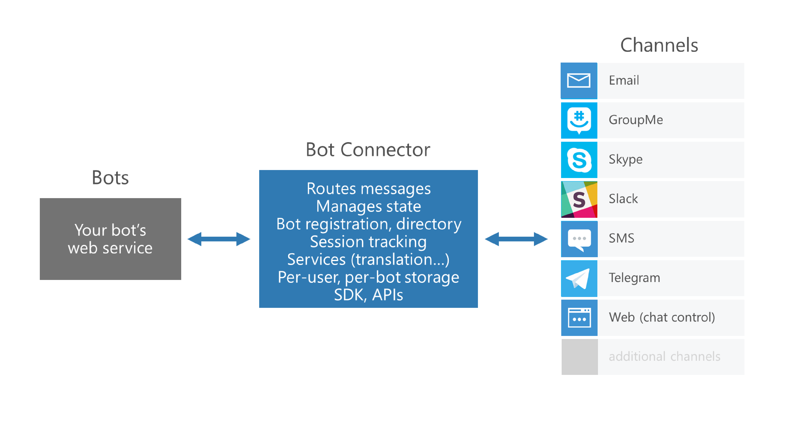
Microsoft Bot Framework

Slide 16
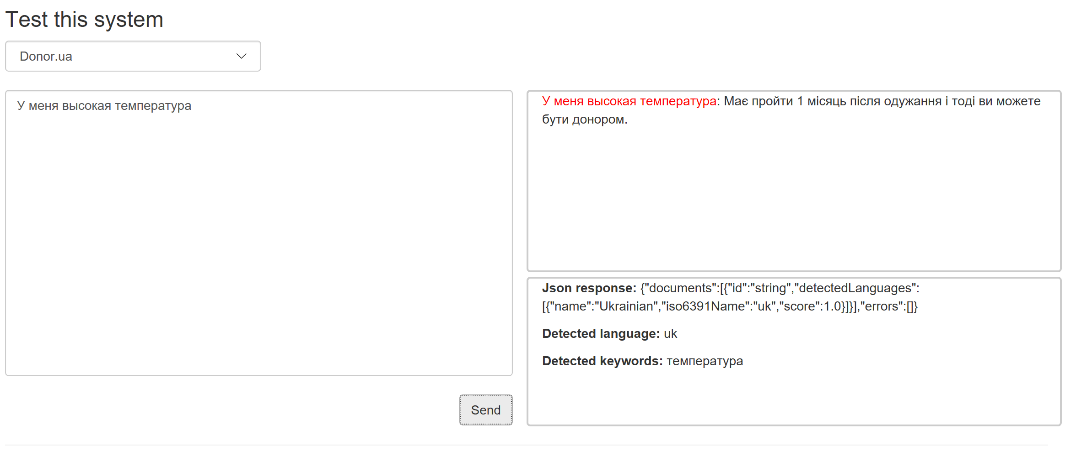
Q&A Endpoint
http://devrain-bots.azurewebsites.net/

Slide 17
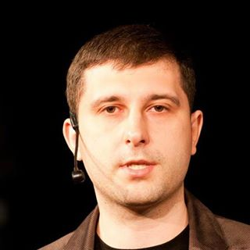
Q&A
Oleksandr Krakovetskyi
CEO DevRain Solutions
alex.krakovetskiy@devrain.com
@msugvnua
https://www.facebook.com/alex.krakovetskiy

